Slide 1
Better late than never
Group 3 - Theresia Wangke, Fang Yi Lin, Benito Jimenez Jaso, Shivam Bhatt

Slide 2
… but not really.
Better on time than late

Slide 3

Problem Statement
In this modern world, people are no stranger to online deliveries.
Especially in the e-commerce industry, where lots of platforms are competing with one another, customers has formed some sort of expectation on what their purchase experience should be.
Product quality, customer service, expected delivery date…
Understanding the relationship between customer satisfaction and repeat purchase behavior with order delivery performance is key for e-commerces to keep customers and stay afloat.

Slide 4
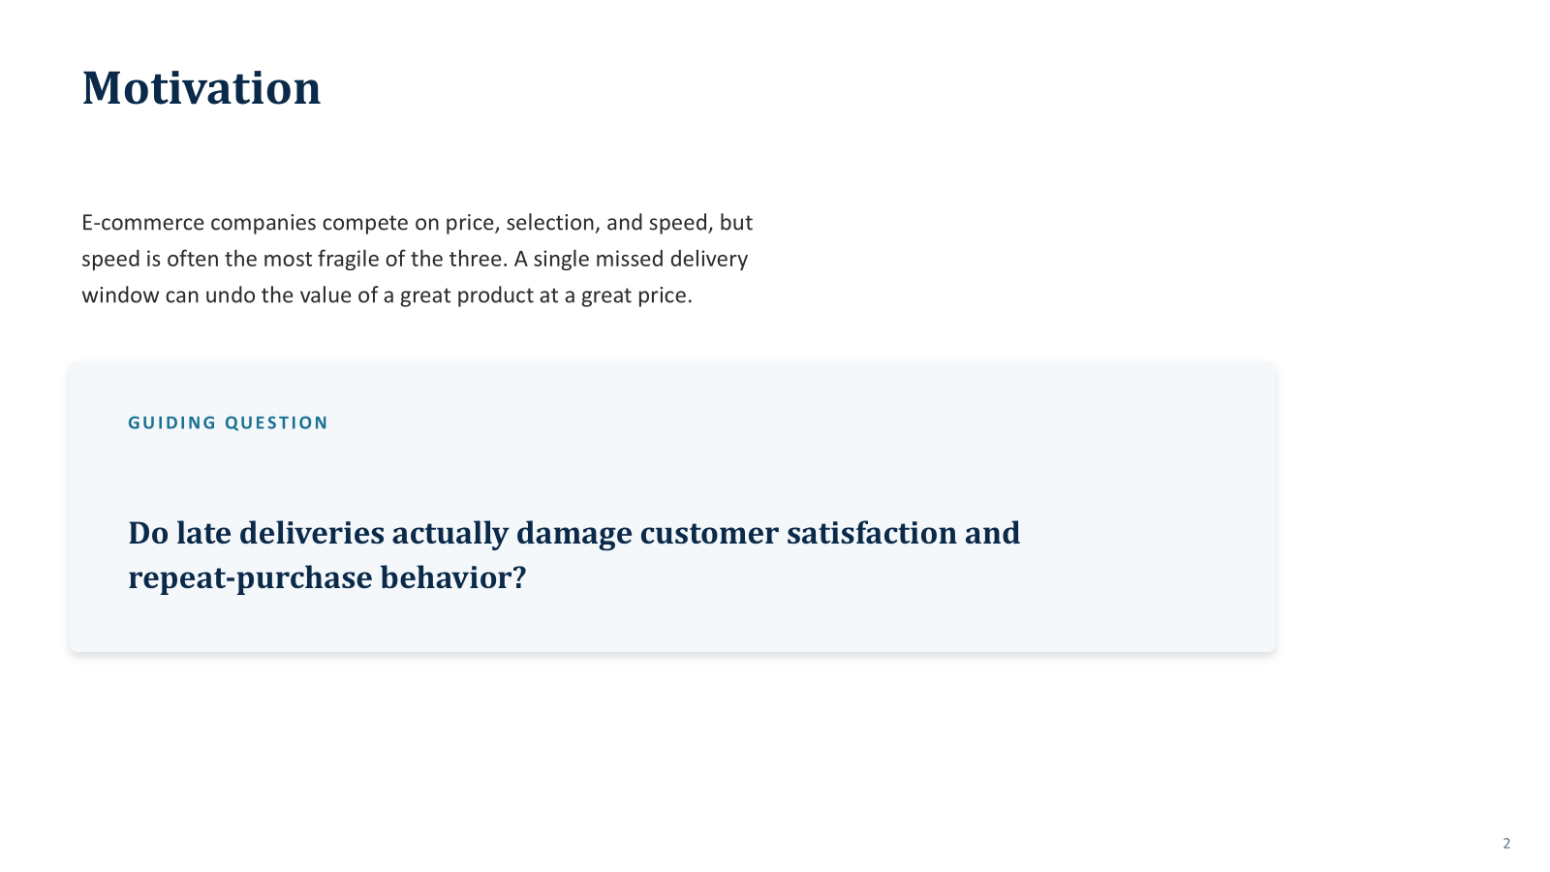
Guiding Question
E-commerce companies compete on price, selection, and speed. But speed is often the most fragile of the three. A single missed delivery window can undo the value of great product at a great price.
So we raise the question...

Slide 6
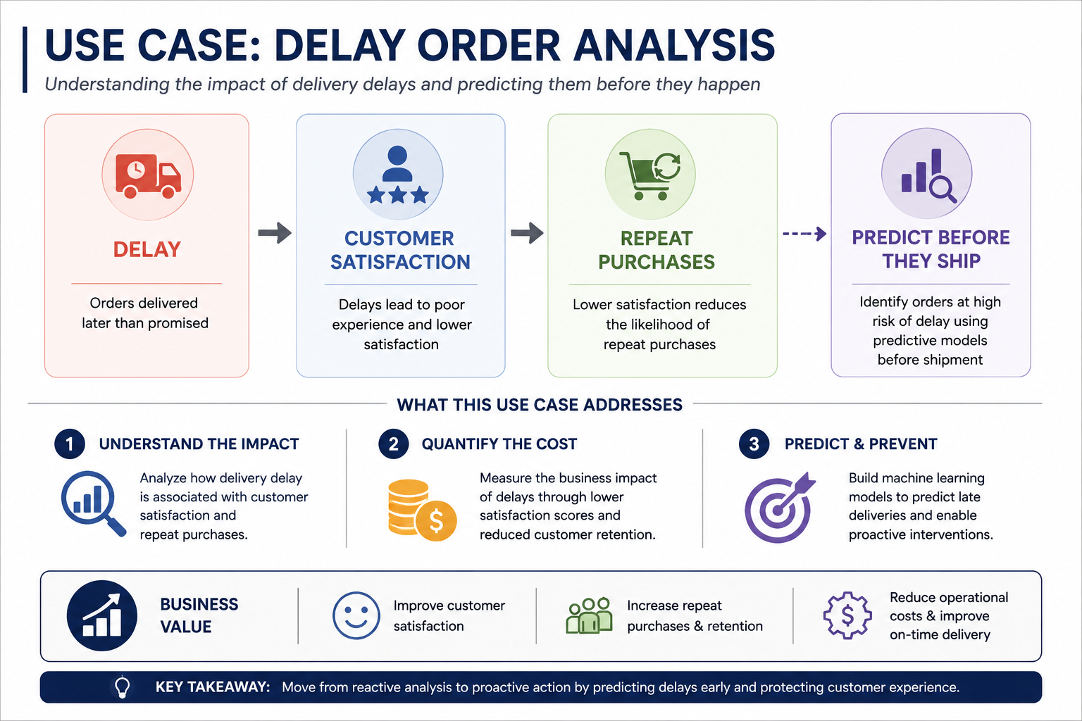
Use Case: Delivery Delay Analysis
Understanding the impact of delivery delays and predicting them before they happen

Slide 7
Setting up the Foundation

Slide 8
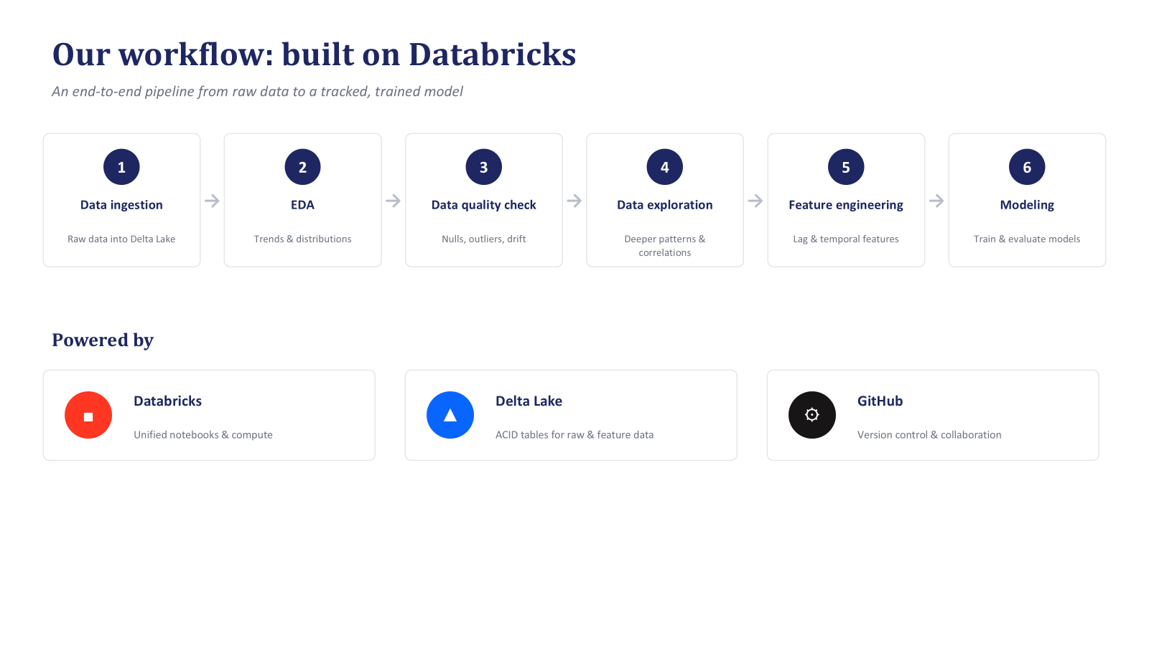

Slide 9
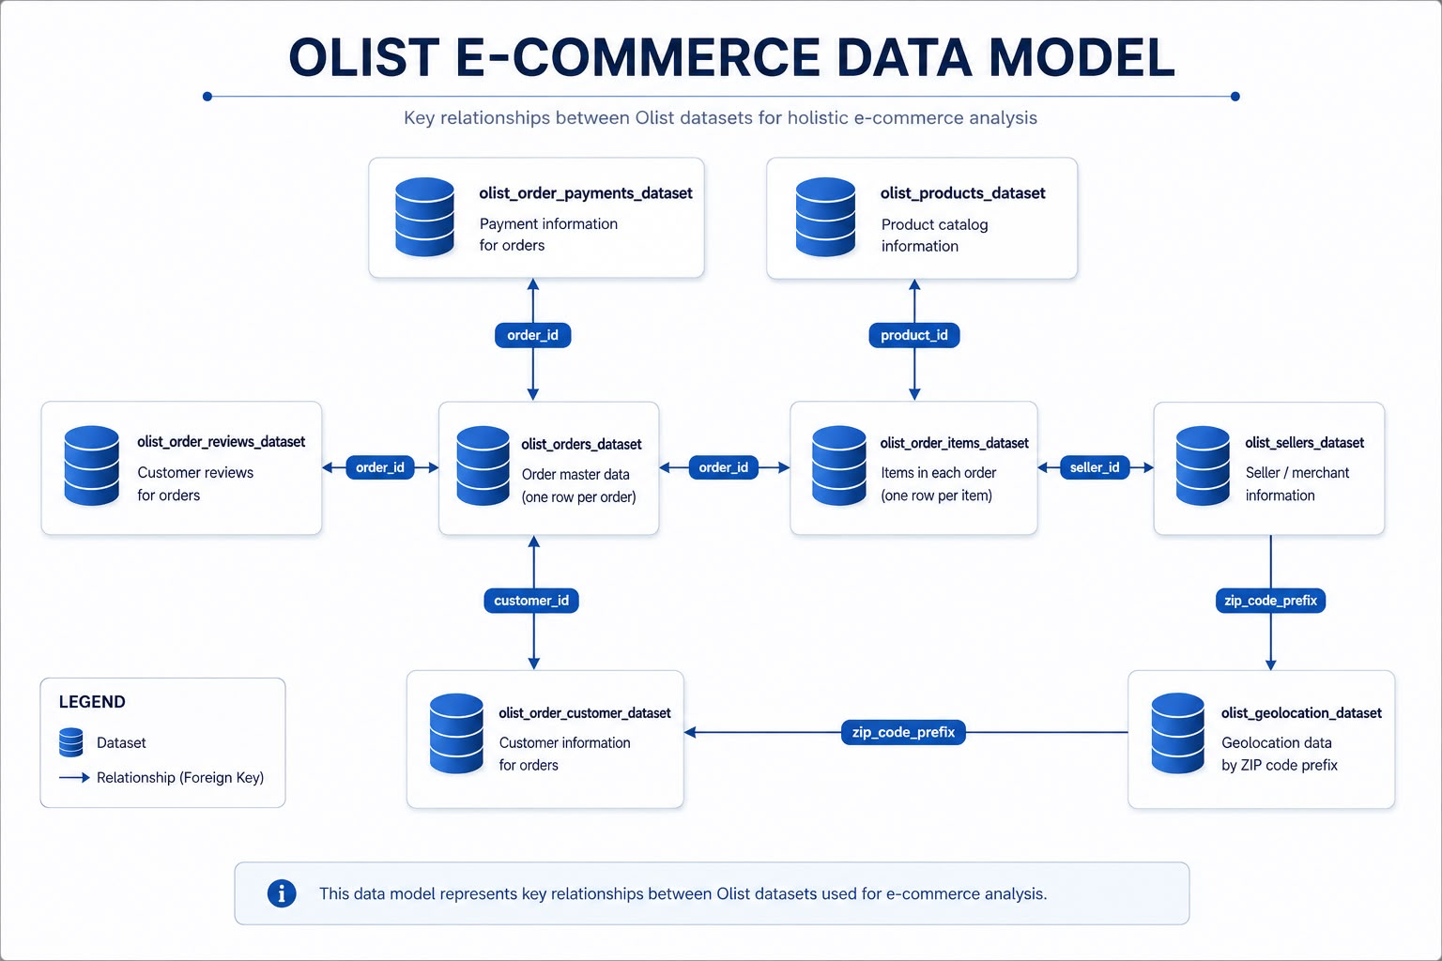

Slide 10
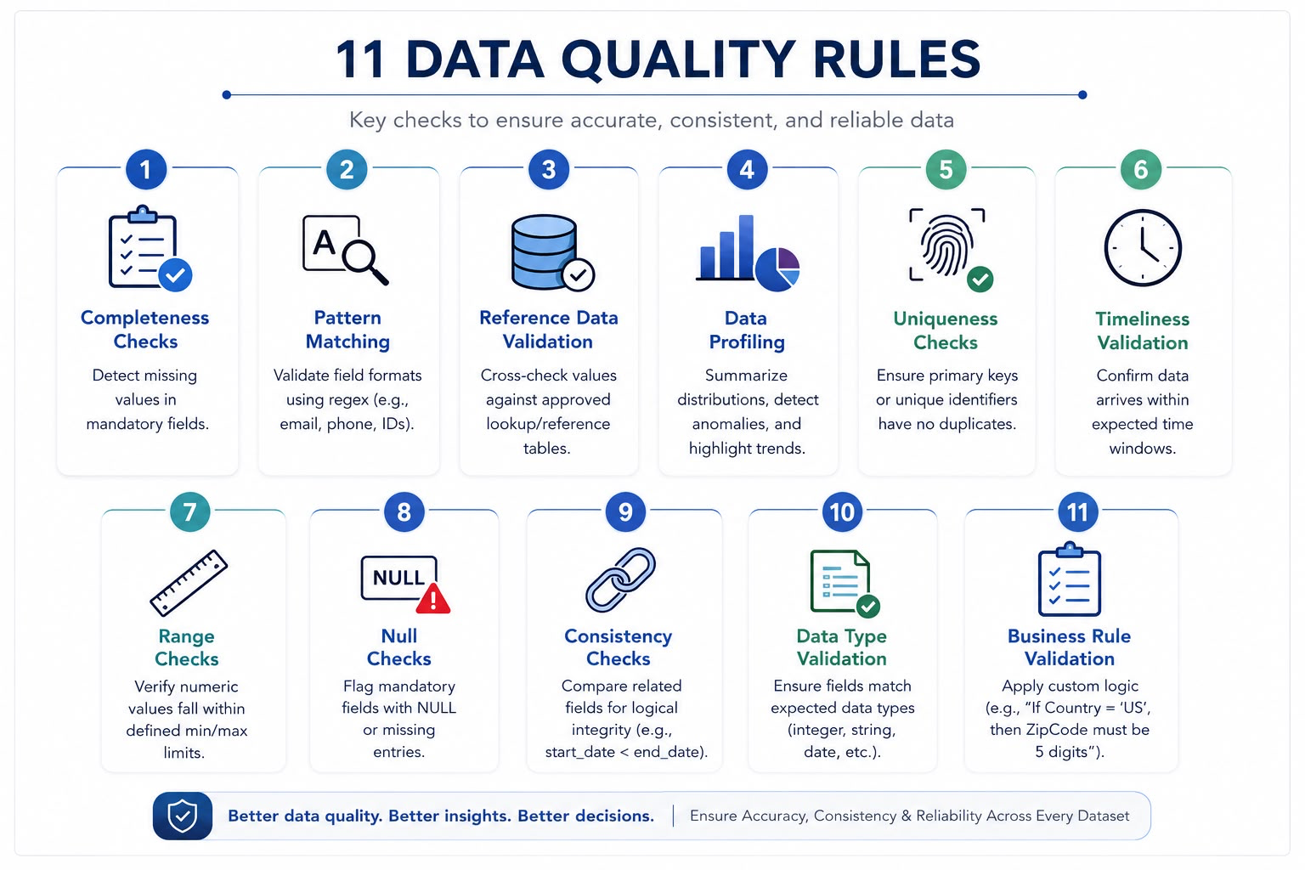

Slide 11
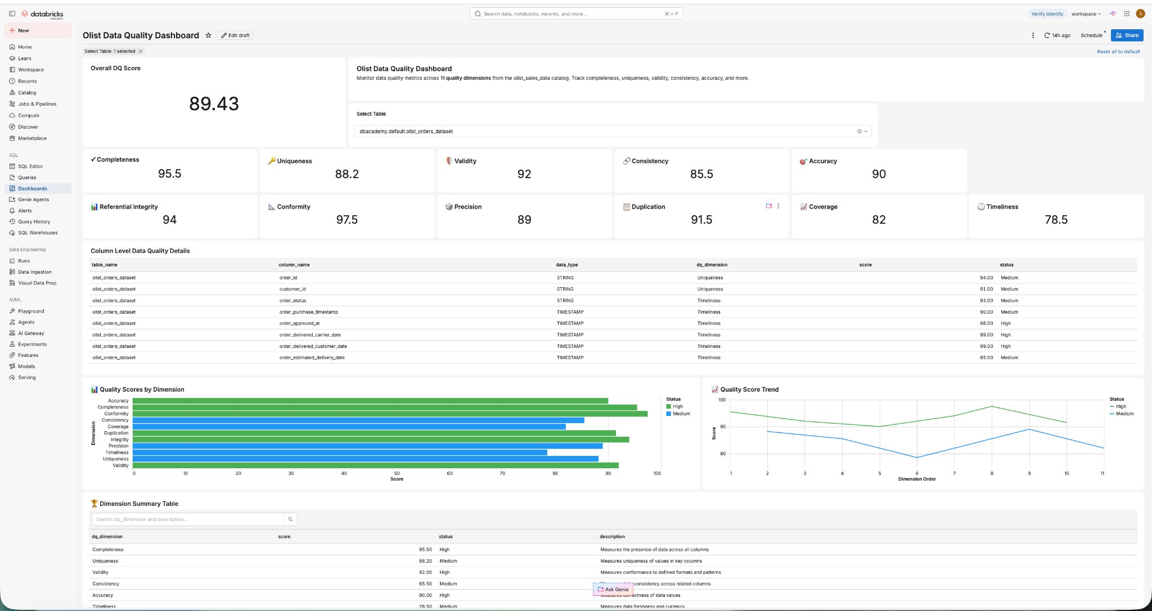

Slide 12
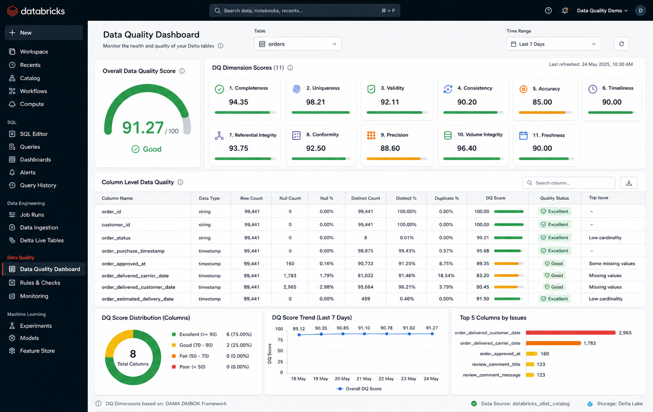

Slide 13
Business Insight

Slide 14
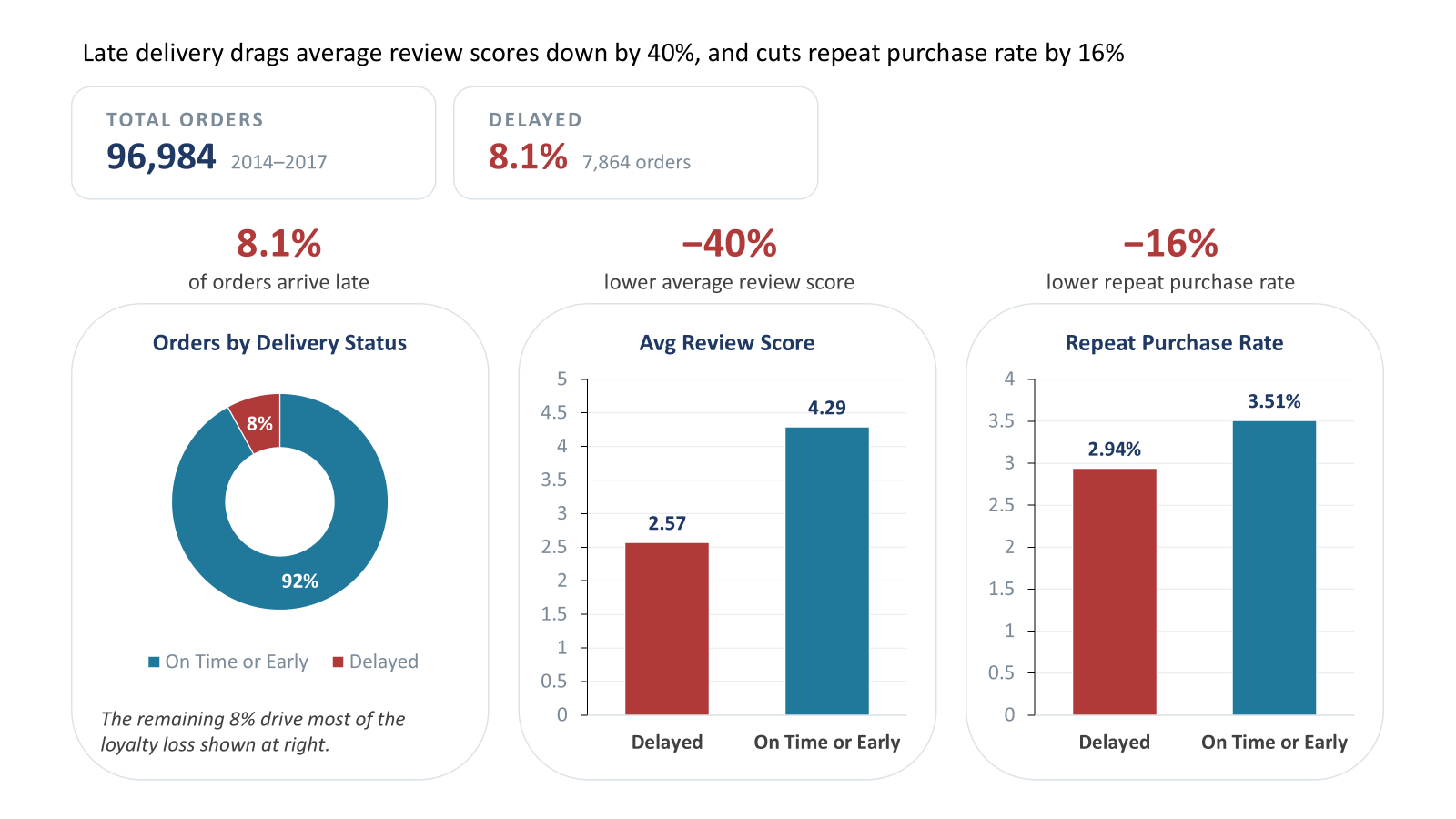
Late delivery drags average review scores down by 40%
and cuts repeat purchase rate by 16%
Notes:
Based on the cleaned data, we found some interesting insights.
Although only 8.1% of orders arrive delayed, that small segment drags average review scores down by 40%, and cuts repeat purchase rate by 16%
So that made us want to dig deeper into two relationships: first, delays and review scores, and second, delays and repeat purchases.

Slide 15
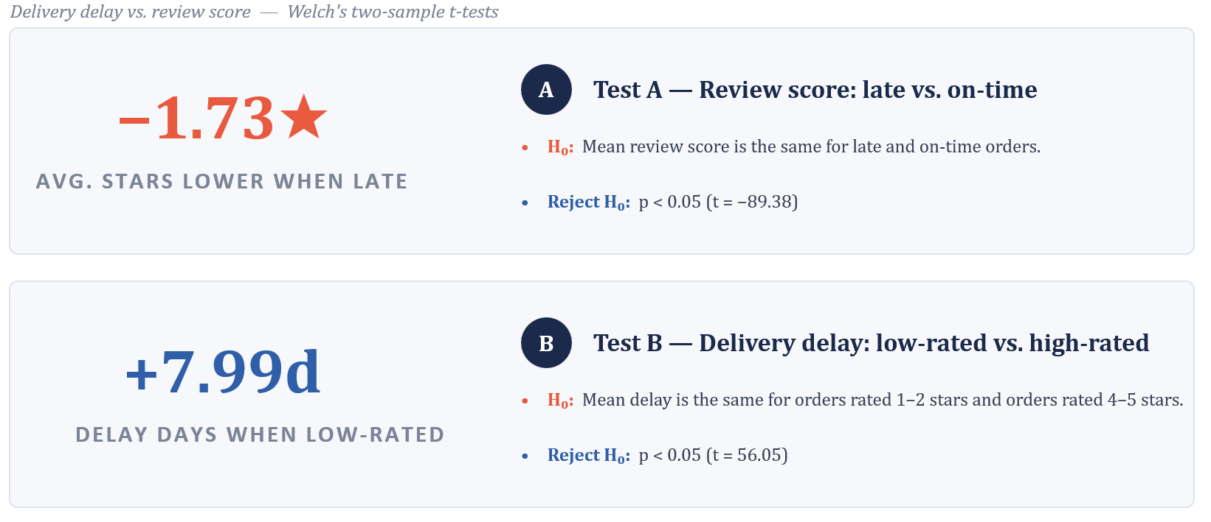
Delays have significant impact on customer satisfaction
Notes:
To test the first relationship, we used a t-test, since we're comparing a numeric variable — review score — across two groups: on-time orders and delayed orders.
Our hypothesis was that the average review score would be the same for both groups. But the test showed that average review score is not the same. To double-check this, we also ran it the other way around — grouping orders by review score instead, high-rated versus low-rated, and comparing their delay rates. Same result: the difference was significant again.
So both tests point to the same conclusion — delays really do have a significant impact on customer satisfaction.

Slide 16
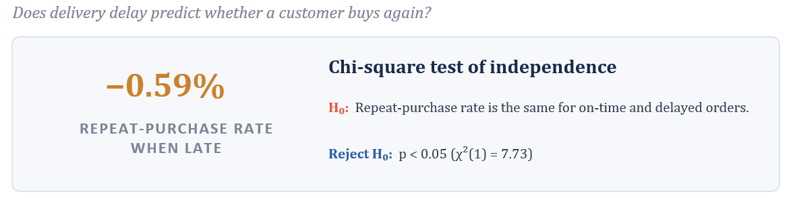
Delays have significant impact on Customer Retention
Notes:
Next, we looked at repeat purchases — that's a yes-or-no variable, so this time we used a chi-square. And again, we found a significant relationship: repeat purchase rates is not the same for on-time versus delayed orders.
So overall, what we're seeing is that delivery delays clearly hurt both customer satisfaction and customer retention. And that leads into our next step — figuring out what conditions are most likely to cause these delays

Slide 17
Delay Prediction

Slide 18
Feature Engineering
SOURCE DATA
Preparation Pipeline
Original Feature Set
Orders
12 original features
1
Retained completed deliveries
Estimated delivery window
Purchase month, weekday & hour
Order & freight value
Item, product & seller counts
Average weight & volume
Same-state share
Order items
2
Converted timestamps into delivery intervals
96,454
late_order
Products
3
Aggregated items to one row per order
order-level observations
0 = on time / early 1 = late
Transformed Feature Set
Customers
Skewness-adjusted features
4
Combined product & geographic information
Log-transformed: order value, freight value, product weight, product volume, delivery days
Binary flags: multiple items, multiple products, multiple sellers
Sellers
Removed missing inputs & prevented leakage
5
80/20 stratified split | Class balancing | Scaling for Logistic Regression and Neural Network

Slide 19
Modelling
Logistic Regression
Model | Accuracy | Precision | Recall | F1
Original Logistic Regression | 0.581 | 0.118 | 0.644 | 0.199
Transformed Logistic Regression | 0.588 | 0.119 | 0.640 | 0.201
Original Random Forest | 0.792 | 0.202 | 0.528 | 0.292
Transformed Random Forest | 0.791 | 0.201 | 0.533 | 0.292
Neural Network | 0.683 | 0.154 | 0.650 | 0.249
Interpretable linear baseline
Tested with original and transformed features
Random Forest
Captures nonlinear relationships
Tested with original and transformed features
Transformations produced negligible improvement over the original features.
KEY FINDINGS
Neural Network
Best precision: Original Random Forest — 0.202
Two hidden layers
Original standardized features
Balanced training sample
Best recall: Neural Network — 0.650
Best F1: Original and Transformed Random Forest — 0.292
Transformations changed performance by less than one percentage point

Slide 20
Dashboard Demo

Slide 21
What’s Next…
Turning delay prediction into delay prevention
Seller-Level and Logistics Partner Accountability
Rank sellers and logistics partner by late-order rate
Flag chronic offenders
Real-Time Triage at Shipment
Route the delay-risk model into live operations
Auto-flag high-risk orders for expedited handling
Can we transform delay’s association with customer dissatisfaction into a good customer service?
Platform Voucher for Next Order
If your order was delayed, you’re given a small discount for your next order
What’s the optimal voucher amount that will maximize customer retention but minimize platform expense?

Slide 22
Links to the Project
Databricks Notebook : https://dbc-9be97a69-c520.cloud.databricks.com/editor/notebooks/530294719074615?o=7474652451077049#command/8078495091479907
Github Link : https://github.com/shivambhatt35/Better-late-than-never
Presentation : https://docs.google.com/presentation/d/1xe78iy3k0WDrTWiHSMP0OUK1W6T1kGDW/edit?slide=id.p1#slide=id.p1

Slide 23
Q&A

